Slide 1
Profile as a Service Scenario One
Clara’s 1st Day at Work in the GoC
Wow, there is a lot on this page!
5 Mandatory fields! Wow…
Hi Clara, I’d like you to create a profile in Profiles. It’s mandatory. I’ll send you the link by email
Do I have time for this right now?
What is GC Profile?
The Manager explains, in essence, it is a way for HR, Managers and Colleagues to learn about each other.
Clara’s first day…
Clara’s Manager sends the link when she returns to her desk.
Clara gets the email and accepts the invite clicks link, goes to profile page.
On the Profile page, Clara sees her partially populated Profile exists; her name, her new work email address, and lots of fields.
Clara considers whether if she has time for this “profile thing.”
It’s kind of like
LinkedIn!
I got this! LinkedIn was quick & easy, and it was worth it! It helped me get this job, after all.
Clara returns to her Profile She and sees that there are other fields where she can add to her profile, like the others, but they do not appear to be as important, so she will come back later.
Then she chooses to look at other colleagues profiles to see if hers profile measures up.
She notices some Jean has more information in his profile.
Clara’s Manager logs into her Profiles Dashboard later that afternoon. She sees 5 new notifications. On the notification page, she sees Clara has filled out the mandatory profile requirements.
Clara remembers the manager suggesting the profile page is ”Kind of like Facebook but more like LinkedIn - have you done one of those before?” She remembers her manager saying “Your colleagues can get to know you better”…So she feels good about providing more information about herself in a professional spirit.
So, Clara happily fills in the fields : Job title, company (department) education, work experience, skills. and more.
She completes the fields and clicks ‘Update’.

Slide 2
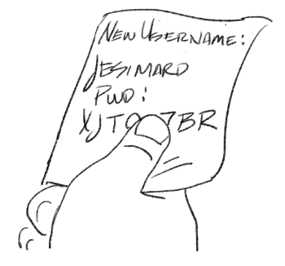
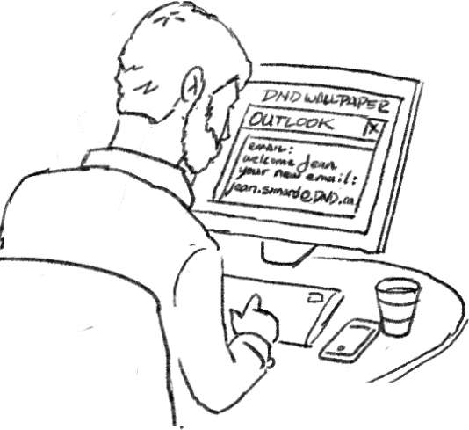
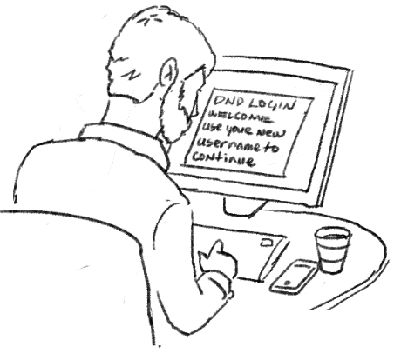
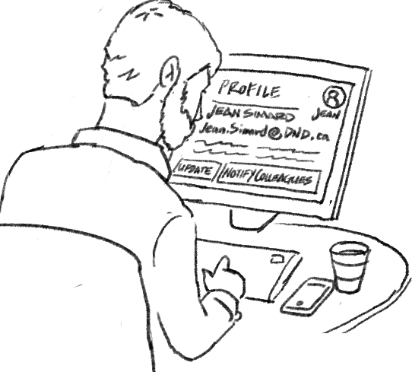
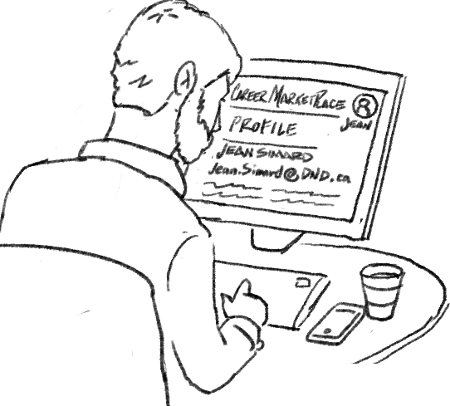
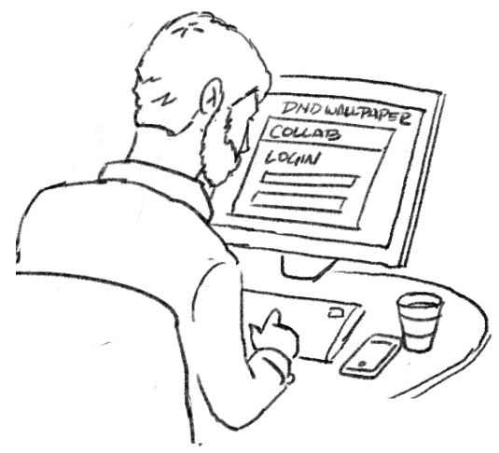
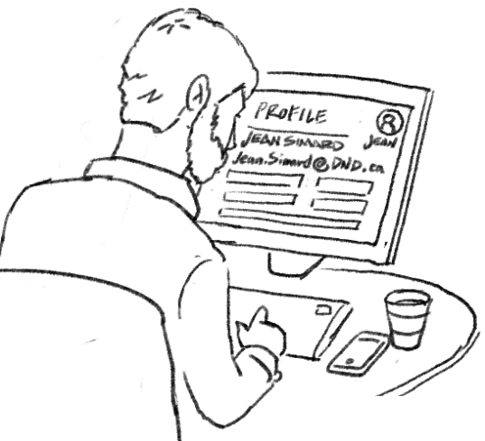
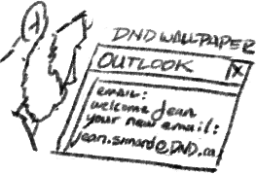
Profile as a Service Scenario Two
Jean refers to a note he made before his old TBS email account was closed. It has his new DND username & password so he could log into his new DND machine & the DND network
Jean checks his email and notices he has no meetings and no immediate work to attend to.
Jeans 1st Day at his new GoC posting
Jean logs into the DND network and changes his password to something he remembers. Now he can get his email, and start working!
It’s my 1st day, but I have no assigned projects. Now would be a good time to update my Profile to reflect all the new stuff regarding my new job. I need my old and new colleagues to know what’s going on, and how I can help!
Jean just switched ministries (from TBS to DND) because he got a promotion by moving to DND
Jean’s job description & job title has changed from Administrator to Senior Administrator, as well as who he reports to in the org chart.
Jean used Collab to create his Profile when he was at TBS. So he opens up Collab on his browser and logs in with his TBS email & Profile/Accounts password
Now he logged into Collab, Jean selects his avatar to access his profile. Jean chooses edit profile. Jean updates his new email address, job title, job description, Ministry and Department as well as who he reports to using all the relevant fields on the page.
Excellent! It looks like the Profile changes I made on Collab have also appeared in Career Marketplace! Now my colleagues AND the public know about my new job, AND the Market place has my up-to-date job Profile in case someone has a new opportunity for me, or I decide to apply for a new opportunity
Jean is happy with all the information he has changed, and chooses “Update Profile” & chooses “Notify Colleagues/Community”.

Slide 3
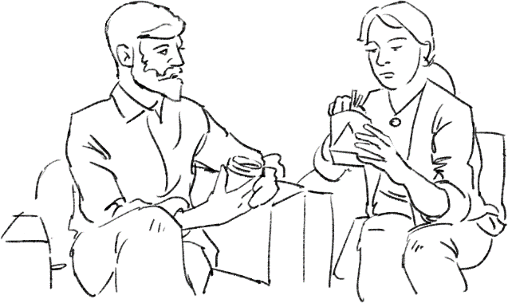
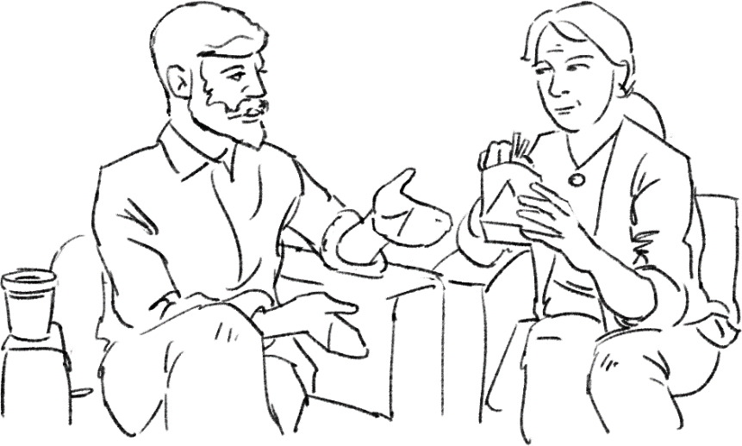
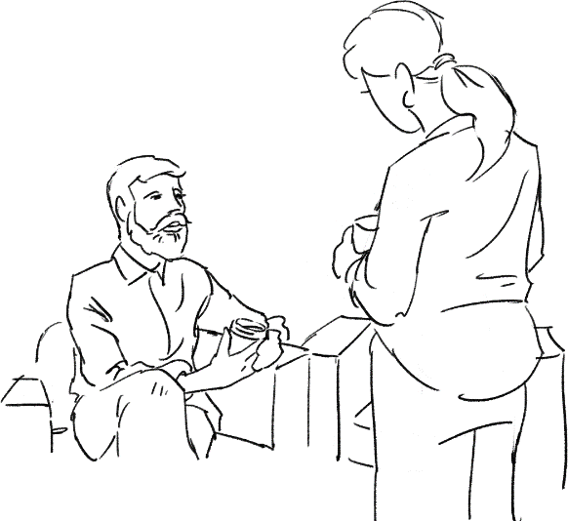
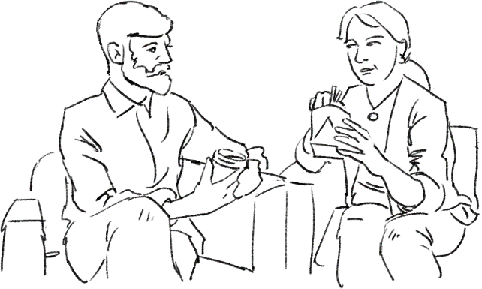

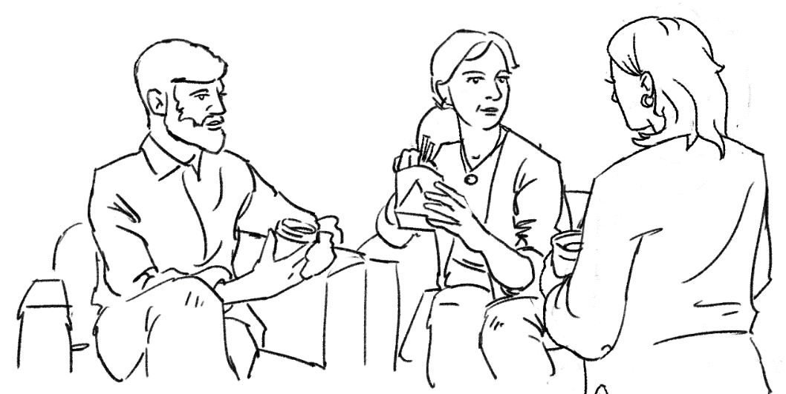
Profile as a Service Scenario Three v02
How are settling into your new job?.
It’s mandatory because HR wants everyone to have some sort of online presence. It makes it easier for HR to collect basic data too.
Jean & Clara discuss the value of having a profile.
Hey Jean!
Hi Clara!
So far, so good. It’s my first job in the government, actually. Mia my manager asked me to fill out some fields in a profile because it was mandatory for this job, and I’m not sure why? No other job has told me to fill out a profile before.
Jean and Clara cross paths in the lunch room at the DND building…
So this is just for the benefit of someone else?
: No, I think it benefits us as well too. I see it as a sort of business card. It has all of your information condensed making you easy to find for people who need to get in touch with you.
I think they’re good for networking. Sure, people can find you with those mandatory fields, but if there’s nothing beyond that they don’t really know much about you.
Hey Liz! Have you met Clara before? We’re talking about the profile you’ve got to fill out when you start working for the government, and how they help you network.
We were introduced, but we haven’t really had a chance to talk to each other.
There’s way more than just those mandatory fields though. What’s the point of those? I saw that yours was pretty filled out, so you must have seen a reason to do that.

Slide 4
I feel like I kind of know you already because I looked through my coworkers’ profiles on my first day. Yours is the most filled out! You even have that “About Me” section filled that everyone seems to avoid.
I don’t know why everyone avoids it? Sure it’s hard to write about yourself, but if your profile isn’t totally filled out you’re missing an opportunity to brand yourself.
Brand yourself? Networking I get, but why do you need a brand?
It’s kind of like an author bio on the cover of a book. The rest of the profile is fill-in-the-blanks, but having everything filled out is where you can truly express the version of yourself that you want the world to see. People can imagine you as a real person.
Brand yourself? Networking I get, but why do you need a brand?
Looks like I’ll have to too!

Slide 5
Discovery Research – User Scenario Storyboards
Scenario One:
Clara is asked by her manager to create a (mandatory) profile. No Profile exists, just an email account & 1st last name(?)
Scenario Two:
Jean has switched ministries, job description and job title and has chosen to update his Profile to reflect this
Scenario Three:
Jean & Clara discuss the value of having a profile (& manager). Clara becomes more motivated to complete her profile beyond the basic job title, department, contact info and manager.
Discovery Research – User Scenario Storyboards worth considering
Scenario:
Ann wants to share their GC Profile after a meeting/convention/trade show (?)
Scenario:
Geoff is active on Collab. Geoff wants to create a collection/group of favourite (often accessed) Profiles
Scenario:
Kelly wants to Delete her profile (retirement) user does not want to be ”in the system” anymore. (for privacy) (for closure)
Scenario:
Becky is active on Collab & Profile, moves to a different department, but the new team is not active on the Collab platform. What does she do?
Career-Based (Profile-oriented) Scenario:
Kelly wants to apply for jobs she has seen on Connex but she has no Profile on Connex
Career-Based (Profile-oriented) Scenario:
Tom wants to see review the profiles of the candidates who have responded to a Job posting on Connex
Project-Based Scenario:
Haley is part of a project team and is not sure what tools she should use on Collab. Are other team member’s Profiles one of the those tools?

Slide 6
Scenario One: New employee is asked to create a profile.
Manager visits Clara on her 1st day & asks her to join “GC Profile”. “What is GC Profile?” Clara asks. The Manager explains, in essence, it is a way for HR, Managers and Colleagues to learn about each other.
Email is sent by manager to profile page.
Email received & read. Email has link sending Clara to profile page. Clara clicks link, goes to profile page.
Clara sees her partially populated GC Profile exists, just an email account and her name and lots of fields (is she feeling overwhelmed?).
She sees 5 mandatory fields (no Department, no job title, no manger) Is Clara happy to see this, is she confident that she is at the right place?) add – thought bubble, facial expression.
Clara remembers the manager suggesting the profile page is ”kinda like facebook but more like linked in - have you done one of those before?” She remembers her manager saying “Your colleagues can get to know you better”…So she feels good about providing more information about herself in a professional spirit.
Clara notices the 5 mandatory fields align with what she remembers on Linked In. Linked in was easy she remembers!
So, Clara happily fills in the fields : Job title, company (department) education, work experience, skills. and more. She completes the fields and clicks Update.
Then she chooses to look at other colleagues profiles to see if hers measures up (evaluates her profile against others) before deciding
she is done with that task for the time being. She sees that there are other fields, but they do not appear to be as important, so she will come back later.
she comes back because she sees people who have more interesting profile….back to
The manager sees that Clara has filled in her basic profile on his/her dashboard.

Slide 7
Scenario Two:
An employee has changed jobs and changed their department and (chooses, is told (?)) to update their GC Profile
Jean just switched ministries (from TBS to DND) because he got a promotion by moving to DND
Jean’s job description & job title has changed from Administrator to Senior Administrator, as well as who he reports to in the org chart
Jean’s email address has changed
Jean’s head office location (physical address) has completely changed
Jean wants to update his Profile; he has time on his 1st day because no projects have started yet.
Jean remembers he made a Profile in GCCollab
Jean wants to use the content of his updated Collab profile on Linked In, later
Jean logs into Collab and selects his avatar to access his profile
Jean chooses edit profile
Jean updates his job title, job description, Ministry and Department as well as who he reports to using all the relevant fields on the page
Jean is happy with all the information he has changed, and chooses “Update Profile” & chooses “Notify Colleagues/Community”.
Jean wants to validate that the information he has changed appears correctly in other systems (Connex, Career Marketplace)
Jean exits Collab and chooses the Connex icon in the app tray
Jean selects his avatar in Connex to access his profile
Jean reviews his profile in Connex and sees that his profile changes from Collab appear in Connex

